Slide 1


Slide 2
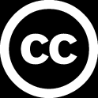
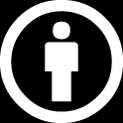
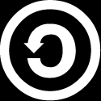
This course material by Osama Salah is released under the following license:
Attribution-ShareAlike 4.0 International (CC BY-SA 4.0)
Conditions for use are published here:
https://creativecommons.org/licenses/by-sa/4.0/

Slide 3
Acknowledgement
I would like to thank and acknowledge the following people for their valuable contributions to this course material:
Have your name and effort acknowledged here!!!

Slide 4
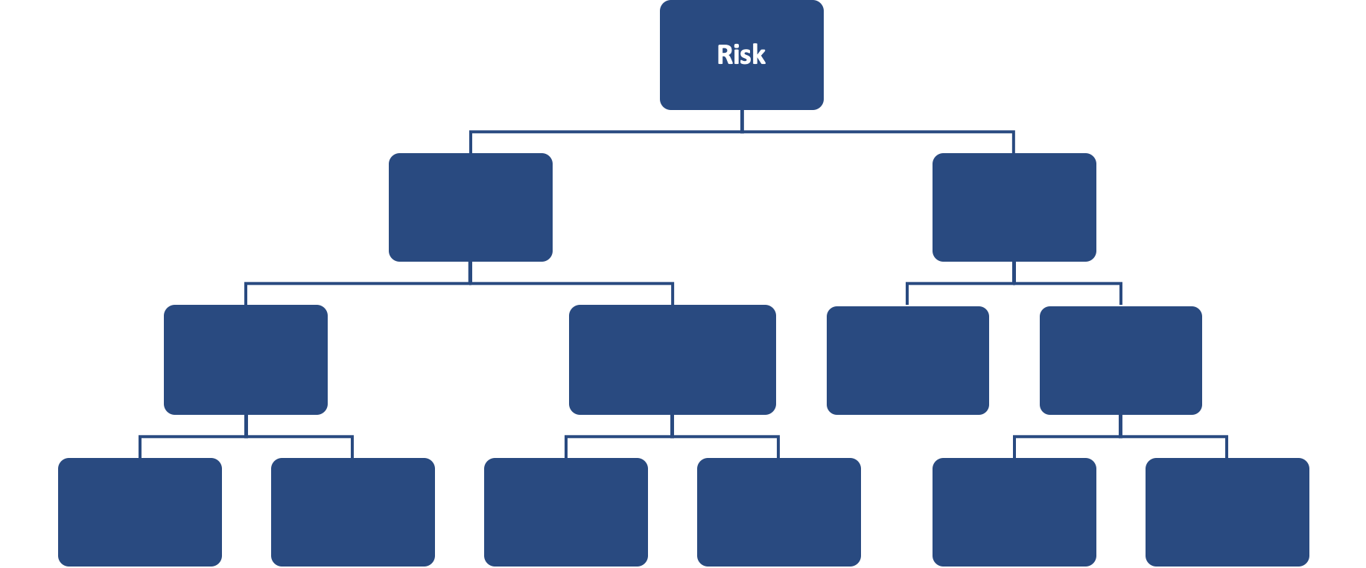
FAIR Open Course Module 01b – Cognitive Biases Ver. 0.2

Slide 5
Cognitive Biases
“A cognitive bias is a systematic pattern of deviation from norm or rationality in judgment. Individuals create their own "subjective social reality" from their perception of the input. An individual's construction of social reality, not the objective input, may dictate their behaviour in the social world. Thus, cognitive biases may sometimes lead to perceptual distortion, inaccurate judgment, illogical interpretation, or what is broadly called irrationality.”
Source: https://en.wikipedia.org/wiki/Cognitive_bias

Slide 6

Cognitive Biases
In plain English it is a term that describes systemic ways in which individuals make judgements and decisions that deviate from what would be accepted or what is inconsistent with one’s values.
Cognitive biases were introduced by Amos Tversky and Daniel Khaneman in 1972.
Khaneman was awarded the Nobel Memorial Prize in Economic Sciences (shared with Vernon L. Smith) for his work on the psychology of judgement and decision making, as well as behavioral economics.
Image Source: Wikipedia

Slide 7
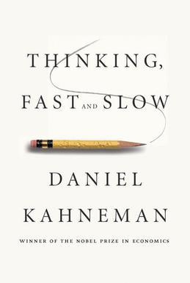
Cognitive Biases
In 2011 Kahneman released his bestseller “Thinking, Fast and Slow”
The central thesis of the book is that we have two modes of thought:
“System 1”: Fast, instinctive, automatic, unconscious and emotional
“System 2”: Slow, deliberative, conscious, calculating, logical
The problem is when we use “System 1” in situations where “System 2” would serve us better.
Image Source: Wikipedia

Slide 8
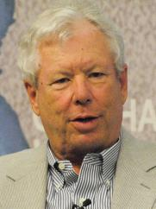
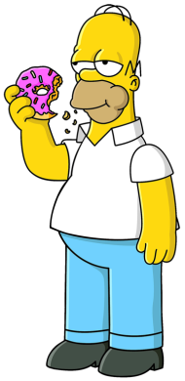
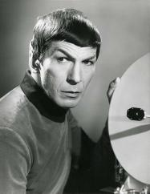
Cognitive Biases
In 2017, Professor Richard Thaler, was awarded the Nobel Memorial Prize in Economic Sciences for his contributions to behavioral economics.
In his bestseller “Nudge” he also talks about “System 1” and “System 2”, however he personified them as “Homer” and “Mr. Spock”.
Image Source: Wikipedia
Image Source: Wikipedia
Image Source: Wikipedia

Slide 9
Anchoring Effect
“Anchoring or focalism is a cognitive bias where an individual relies too heavily on an initial piece of information offered (considered to be the “anchor") when making decisions."
https://en.wikipedia.org/wiki/Anchoring
“It occurs when people consider a particular value for an unknown quantity before estimating that quantity.”
“…the estimate stays close to the number that people considered.”
“Any number that you are asked to consider as a possible solution to an estimation problem will induce an anchoring effect.”
“System 1 tries its best to construct a world in which the anchor is the true number.”
Daniel Khaneman, Thinking, Fast and Slow

Slide 10
Anchoring Effect - Example
“For example, the initial price offered for a used car, set either before or at the start of negotiations, sets an arbitrary focal point for all following discussions. Prices discussed in negotiations that are lower than the anchor may seem reasonable, perhaps even cheap to the buyer, even if said prices are still relatively higher than the actual market value of the car”
https://en.wikipedia.org/wiki/Anchoring

Slide 11
Anchoring Effect - Example
“As a second example, in a study by Dan Ariely, an audience is first asked to write the last two digits of their social security number and consider whether they would pay this number of dollars for items whose value they did not know, such as wine, chocolate and computer equipment. They were then asked to bid for these items, with the result that the audience members with higher two-digit numbers would submit bids that were between 60 percent and 120 percent higher than those with the lower social security numbers, which had become their anchor.” https://en.wikipedia.org/wiki/Anchoring

Slide 12
Dealing with Anchoring Effect
Try to avoid anchoring by not discussing numbers early in the analysis. Allow SMEs to share their estimates anonymously.
Try to bring in multiple anchors our counter-anchors.
Don’t fixate on some initial estimates. Be open to adjust if new information supports the adjustment.
Estimation calibration exercises help us make estimates that match our confidence levels. Estimate and question the boundaries (min, max) separately.
The Equivalent Bet forces us to question the validity of our estimate.
Of course, using data from trustworthy sources supports validating our estimates.
Activating System 2 requires energy, make sure you are not exhausted.

Slide 13
Availability Heuristics
“The availability heuristic is a mental shortcut that relies on immediate examples that come to a given person's mind when evaluating a specific topic, concept, method or decision. The availability heuristic operates on the notion that if something can be recalled, it must be important, or at least more important than alternative solutions which are not as readily recalled.
Subsequently, under the availability heuristic, people tend to heavily weigh their judgments toward more recent information, making new opinions biased toward that latest news.”
https://en.wikipedia.org/wiki/Availability_heuristic

Slide 14
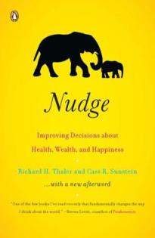
Availability Heuristics
“We define the availability heuristic as the process of judging frequency by “the ease with which instances come to mind.”
"They (people) assess the likelihood of risks by asking how readily examples come to mind. If people can easily think of relevant examples, they are more likely to be frightened and concerned than if they cannot.”
Daniel Khaneman, Thinking, Fast and Slow
Richard H. Thaler and Cass R. Sunstein, Nudge: Improving Decisions about Health, Wealth, and Happiness,
Image: Wikipedia

Slide 15
Availability Heuristics - Examples
One group is asked to list six instances when they behaved assertively.
The other group is asked to list twelve instances.
The second group, that had to list twelve instances, rated themselves as less assertive than the people that had to list only six.
People who were asked to list twelve incidents in which they had not behaved assertive rated themselves as quite assertive.
“The experience of fluent retrieval of instances trumped the number retrieved.”
Daniel Khaneman, Thinking, Fast and Slow

Slide 16
Availability Heuristics
“The conclusion is that the ease with which instances come to mind is a System 1 heuristic, which is replaced by a focus on content when System 2 is more engaged.”
Daniel Khaneman, Thinking, Fast and Slow

Slide 17
Dealing with Availability Heuristics
Work with teams that have diverse experiences and point of views. This will naturally reduce the likelihood that members recall the same information easily.
Diverse teams are also more likely to challenge each other and provide counter examples.
In quantitative risk management we work with data. We don’t just rely on what we can easily remember or anecdotal “evidence”. We discuss our sources and the rationale of our estimates and reasoning. We activate System 2 thinking. Try to think of ways you might be wrong.

Slide 18
Groupthink
"Groupthink is a psychological phenomenon that occurs within a group of people in which the desire for harmony or conformity in the group results in an irrational or dysfunctional decision-making outcome. Group members try to minimize conflict and reach a consensus decision without critical evaluation of alternative viewpoints by actively suppressing dissenting viewpoints, and by isolating themselves from outside influences.”
https://en.wikipedia.org/wiki/Groupthink
In risk management the desire for harmony can result in the group being willing to take more or less risk than individuals would be willing to take themselves.

Slide 19
Dealing with Groupthink
Facilitator could inform the group about group think bias.
Senior management should confirm that participants are not judged and the focus revolves on collecting the best data and evaluating its fitness as relevant to the model. Stress that every individual contribution counts.
Encourage “out-of-the box” thinking.
Facilitator should focus the discussion around data, it’s source and how trustworthy it is.
Use external experts specifically instructed to challenge the group. The person can also be a “devil’s advocate”.

Slide 20
Dealing with Groupthink
Split a larger group into smaller groups. Split them up into groups where individuals might have different or conflicting interests.
Ask senior management to refrain from expressing opinions.
Facilitator should ensure that if warning signs are raised they get addressed and not ignored.
Facilitator to ensure everyone is contributing.
“Premortem” proposal by Gary Klein (psychologist):
“Imagine that we are a year into the future. We implemented the plan as it now exists. The outcome was a disaster. Please take 5 to 10 minutes to write a brief history of that disaster.”
Daniel Khaneman, Thinking, Fast and Slow
Notes:
https://en.wikipedia.org/wiki/Gary_A._Klein
https://en.wikipedia.org/wiki/Pre-mortem
A pre-mortem — also known as a premortem — is a managerial strategy in which a project team imagines that a project or organization has failed, and then works backward to determine what potentially could lead to the failure of the project or organization.^{[1][2]}
According to a Harvard Business Review article from 2007, "unlike a typical critiquing session, in which project team members are asked what might go wrong, the premortem operates on the assumption that the 'patient' has died, and so asks what did go wrong."^{[1]}

Slide 21
Framing Effect
“The framing effect is a cognitive bias where people decide on options based on if the options are presented with positive or negative semantics; e.g. as a loss or as a gain.
People tend to avoid risk when a positive frame is presented but seek risks when a negative frame is presented.”
https://en.wikipedia.org/wiki/Framing_effect_(psychology)

Slide 22
Framing Effect
For example a discussion about a control that misses 5% of malware samples (negative framing) would be different than a discussion on a control that catches 95% of malware samples (positive framing).
In the FAIR model we would use the 5% in the estimation of vulnerability. The model and it’s taxonomy guides us in using available data correctly and not to be misguided by subjective discussions.

Slide 23
Confirmation Bias
“Confirmation bias is the tendency to search for, interpret, favor, and recall information in a way that confirms one's preexisting beliefs or hypotheses.”
https://en.wikipedia.org/wiki/Confirmation_bias

Slide 24
Dealing with Confirmation Bias
One strategy you can use is to consider the opposite of what you are believing. What if the ”evidence” you are considering was saying the exact opposite?
Have empathy for other peoples viewpoints.
Empower everyone to point out confirmation bias when they suspect it.
Have a diverse group. Listen to dissenting views.
Focus on the data, the source of the data and it’s quality.

Slide 25
Overconfidence Bias
“The overconfidence effect is a well-established bias in which a person's subjective confidence in his or her judgements is reliably greater than the objective accuracy of those judgements, especially when confidence is relatively high.
Overconfidence is one example of a miscalibration of subjective probabilities. Throughout the research literature, overconfidence has been defined in three distinct ways:
(1) overestimation of one's actual performance;
(2) overplacement of one's performance relative to others; and
(3) overprecision in expressing unwarranted certainty in the accuracy of one's beliefs.”
https://en.wikipedia.org/wiki/Overconfidence_effect

Slide 26
Dealing with Overconfidence Bias
We can address this bias with Estimation Calibration Training.
Overconfidence is a result of System 1 trying to construct the best story based on whatever evidence is presented. We need to activate System 2 thinking and instead of stories, anecdotes etc. we focus on data quality.

Slide 27
Gambler’s Fallacy
Imagine we toss a fair coin, and we get 4 times head. What will we get on the fifth time we toss the coin?
?
1/2
1/2
1/2
1/2
Every time we toss a coin there is a ½ probability it might be heads or tails. Each coin toss is independent of the previous toss result.
Notes:
We can’t tell, there is still a 50/50 chance it might be heads or tail.
In the Gambler’s Fallacy people believe that after that many heads it’s time for a tail.

Slide 28
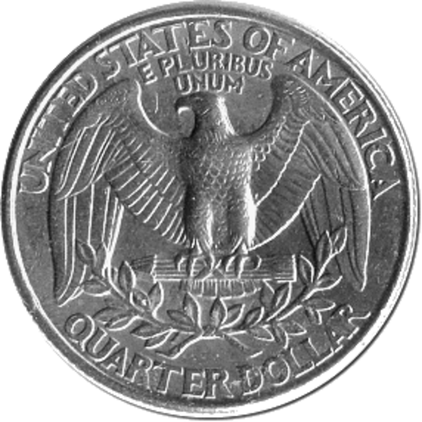
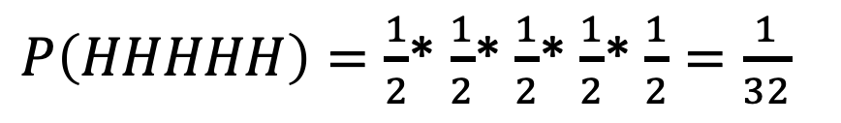
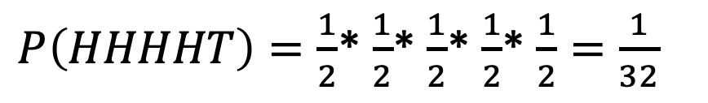
Gambler’s Fallacy
What if we were asking, what is the probability of getting HHHHH?
$P\left(HHHHH\right)=\frac{1}{2}$* $\frac{1}{2}$* $\frac{1}{2}$* $\frac{1}{2}$* $\frac{1}{2}=\frac{1}{32}$
What if we were asking, what is the probability of getting HHHHT?
$P\left(HHHHT\right)=\frac{1}{2}$* $\frac{1}{2}$* $\frac{1}{2}$* $\frac{1}{2}$* $\frac{1}{2}=\frac{1}{32}$
Notes:
We can’t tell, there is still a 50/50 chance it might be heads or tail.
In the Gambler’s Fallacy people believe that after that many heads it’s time for a tail.

Slide 29
Gambler’s Fallacy
“The gambler's fallacy, also known as the Monte Carlo fallacy or the fallacy of the maturity of chances, is the mistaken belief that, if something happens more frequently than normal during a given period, it will happen less frequently in the future (or vice versa).”
https://en.wikipedia.org/wiki/Gambler%27s_fallacy
HHHHH
HTHTH
HHTTH
TTHHT
These sequences all have the same probability of occurring.

Slide 30
Gambler’s Fallacy
The outcome has to be truly random.
In real life some observations might not be truly random.
The gambler’s fallacy might cause you to question yourself. For example you conduct three risk analysis in a row and each time you recommend to accept the risk. You look at the results and start doubting yourself. “Am I accepting too much risk? Maybe the next assessment I need to be tougher with myself and really consider treating it?”
The fallacy works because we believe that outcomes need to even themselves out to be representative of random streaks. This is true for large number of trials, but not smaller ones. (Law of large numbers)

Slide 31
Dealing with Gambler’s Fallacy
Understand basic probability principles.
Trust the model.
Focus on data quality.

Slide 32
Optimism Bias
Optimism bias is a cognitive bias that causes someone to believe that they themselves are less likely to experience a negative event. It is also known as unrealistic optimism or comparative optimism.
It’s essentially believing to be at lower level of risk compared to others. Believing that bad things happen to others, not to us.
Everyone rates them on average better than the rest, which is statistically not possible.
https://en.wikipedia.org/wiki/Optimism_bias

Slide 33
Overcoming Optimism Bias
We work with data from trustworthy sources.
We use calibration estimating exercises to not underestimate the odds we face.
We estimate max, most likely and minimum which helps envisioning a spectrum of possible futures not a single one.
We can question our estimates, try to prove them wrong. Make a new estimate and average the results.
We can use a “premortem” i.e. we imaging a future failure and try to explain the causes (also called ‘prospective hindsight’)

Slide 34
Conjunction Fallacy – The Linda Problem
Amos Tversky and Daniel Kahneman conducted the following test:
Linda is 31 years old, single, outspoken, and very bright. She majored in philosophy. As a student, she was deeply concerned with issues of discrimination and social justice, and also participated in anti-nuclear demonstrations.
Linda is a bank teller.
Linda is a bank teller and is active in the feminist movement.
?
Which is more probable?
https://en.wikipedia.org/wiki/Conjunction_fallacy

Slide 35
Conjunction Fallacy – The Linda Problem
Linda is a bank teller.
Linda is a bank teller and is active in the feminist movement.
Majority of participants choose option 2.
However the probability of two events occurring together is always less than or equal to the probability of either one occurring alone.
https://en.wikipedia.org/wiki/Conjunction_fallacy

Slide 36
Conjunction Fallacy
“The conjunction fallacy (also known as the Linda problem) is a formal fallacy that occurs when it is assumed that specific conditions are more probable than a single general one.”
Amos Tversky and Daniel Kahneman conducted the following test:
https://en.wikipedia.org/wiki/Conjunction_fallacy

Slide 37
Conjunction Fallacy
Another experiment conducted by Amos Tversky and Daniel Kahneman:
“Policy experts were asked to rate the probability that the Soviet Union would invade Poland, and the United States would break off diplomatic relations, all in the following year. They rated it on average as having a 4% probability of occurring.
Another group of experts was asked to rate the probability simply that the United States would break off relations with the Soviet Union in the following year. They gave it an average probability of only 1%.”
https://en.wikipedia.org/wiki/Conjunction_fallacy

Slide 38
Dealing with Conjunction Fallacy
Basic understanding of probability theory is useful.
Analyze the scenario by decomposing it.
Analyzing the scenario visually with diagrams like Venn diagram can help.
Thinking in frequencies rather than probabilities comes more natural. We are forced to use mathematical thinking (System 2 being activated).

Slide 39
Conjunction Fallacy and Frequencies
Gigerenzer revisited the Linda problem using frequencies, and the conjunction fallacy is “drastically reduced”
There are 100 persons who fit the description above (that is, Linda’s). How many of them are:
Bank tellers? __ of 100
Bank tellers and active in the feminist movement? __ of 100
Gerd Gigerenzer, How to Make Cognitive Illusions Disappear: Beyond “Heuristics and Biases”

Slide 40
Paul Slovic's list
Catastrophic potential: if fatalities would occur in large numbers in a single event — instead of in small numbers dispersed over time — our perception of risk rises.
Familiarity: Unfamiliar or novel risks make us worry more.
Understanding: If we believe that how an activity or technology works is not well understood, our sense of risk goes up.
Personal control: if we feel the potential for harm is beyond our control — like a passenger in an airplane — we worry more than if we feel in control — the driver of a car.
Voluntariness: If we don't choose to engage the risk, it feels more threatening.
Children: It's much worse if kids are involved.
Future generations: if the risk threatens future generations, we worry more.
Victim identity: identifiable victims rather than statistical abstractions make the sense of risk rise.
Dread: If the effects generate fear, the sense of risk rises.
Source: Daniel Gardner, The Science of Fear: How the Culture of Fear Manipulates Your Brain
Notes:
Paul Slovic: Psychology Professor, extensively researched human judgement, decision making and risk perception.

Slide 41
Paul Slovic's list
Trust: if the institutions involved are not trusted, risk rises.
Media attention: More media means more worry.
Accident history: Bad events in the past boost the sense of risk.
Equity: If the benefits go to some and the dangers to others, we raise the risk ranking.
Benefits: If the benefits of the activity or technology are not clear, it is judged to be riskier.
Reversibility: If the effects of something going wrong cannot be reversed, risk rises.
Personal risk: If it endangers me, it's riskier.
Origin: Man-made risks are riskier than those of natural origin.
Timing: More immediate threats loom larger while those in the future tend to be discounted.
Source: Daniel Gardner, The Science of Fear: How the Culture of Fear Manipulates Your Brain
Notes:
Paul Slovic: Psychology Professor, extensively researched human judgement, decision making and risk perception.
Equity -> Fairness

Slide 42
General Notes
It’s difficult to recognize when we ourselves fall victims to cognitive biases, however it is is easier to recognize them if others commit them. This is why it’s important that all team members are aware of cognitive biases and can point them out when others fall victim to them.
Have a good and independent facilitator that has no stake in the outcome.
Working in a diverse group is generally a good strategy.
Focus on activating System 2. Work analytically, use the model, use data from trustworthy sources.
Using system 2 requires energy. Make sure the team is energized and not worked out.
Create an environment of trust. It’s about the numbers and fitting them to the model. No one is judged, no one is right or wrong.

